Slide 1
Automatic Test Equipment (ATE)

Slide 2
Incoming Electronic components and PCB testing
In circuit (PCB) component
Testing
Assembled PCB functional Testing
System Assembly and
functional Testing
PCB Assembly
Testing Stages in Electronic System Manufacture

Slide 3
Stimulus devices
Unit or device under test (UUT)
Measuring Devices
Readings
Requirement for testing a system

Slide 4
Comparator
Program
Memory
Control Unit
Display
Measuring Devices
Switching Unit
Stimulus Devices
Interface
Unit under test
Basic ATE System

Slide 5
1. Stimulus devices for generating an appropriate input signal required to test the unit under test (UUT).
(Devices such as power supplies such as voltage or current sources, signal generators and input data for
programmable devices etc.)
2. Measuring devices for measurement of output from the UUT for the test input.
(Devices such as DMM, oscilloscope LCR meters etc. )
3. Switching arrangement for selecting appropriate input or output terminals (test points) to be
connected to the stimulus and measuring devices.
4. Comparison of the test results with the expected or standard results to indicate pass or fail.
Also for diagnosis of faulty component.
5. Interface for connecting the UUT at various points necessary for testing.
(These include, Crocodile clips, edge connectors or a complex connector such as a bed of nails)
6. Display screen to indicate test results
7. Control unit for controlling the overall operation of the ATE system.

Slide 6
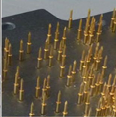
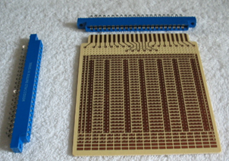
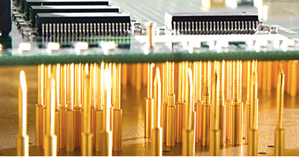
Edge connector
Bed of nails interface

Slide 7
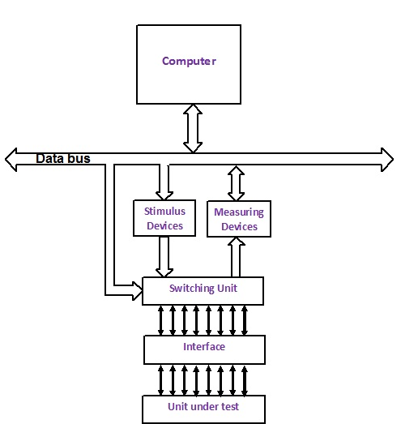
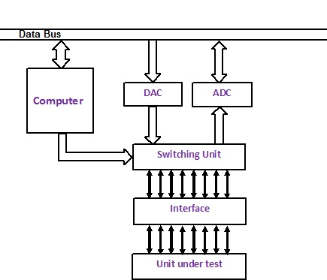
Computer controlled ATE
Computer based ATE

Slide 8
Advantages of ATE
No need of skilled operator for testing
Less human error
Precision in testing and accurate results
Fast testing speed
More complex tests are possible
Test results data can be processed in a required form
Dis-advantages of ATE
High initial cost of the system
Necessary to identify all possible faults and prior to programming the system for testing
Required skilled test and programming engineer for programming ATE system
Need of a complex and expensive interface for access to the UUT
More complex than test system

Slide 9
Reference:
Instruments and Automatic Test Equipment.
An introductory test book.
K. F. Ibrahim.
Longman Scientific & Technical, Longman Group UK Limited

Slide 10
Thankyou

